Slide 1

Project 4:
Instacart objectives
Instacart is an online grocery store that operates through a mobile app, offering customers the convenience of shopping from home. This project analyzes its sales data to uncover customer purchasing patterns, supporting a targeted marketing strategy.
Objectives
Identify peak and low-order times to optimize ad scheduling and product marketing strategies.
Analyze customer purchasing behaviors, including loyalty, demographics, and regional differences, to support targeted marketing efforts.
Methods
Python
Data wrangling & subsetting
Data merging & Deriving variables
Grouping data & Aggregating data
Data visualization with Python

Slide 2
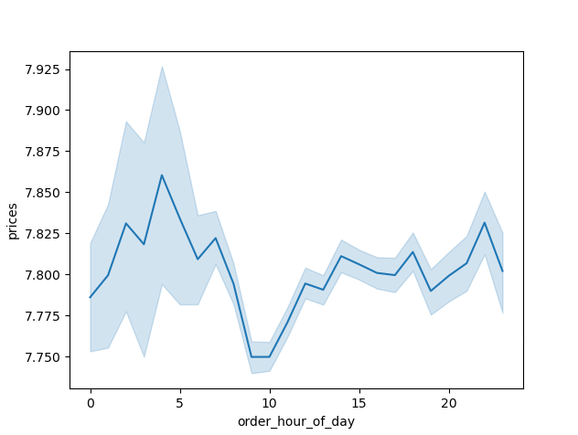
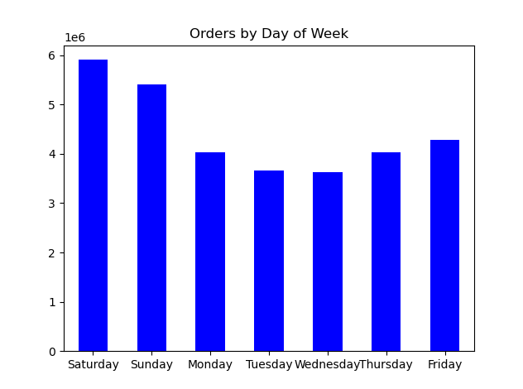
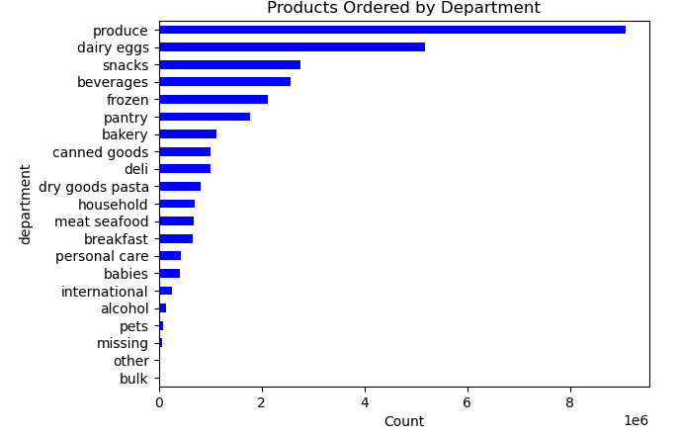
Instacart Analysis
Sales are higher in the early morning, but there is a dip between 9:00am-10:00am.
Saturday and Sunday are the busiest days of the week. Tuesday and Wednesday are the least busy days of the week.
The bar chart shows the best-selling products come from the produce section. The next most ordered from the department section are dairy/eggs, snacks, beverages and frozen.

Slide 3
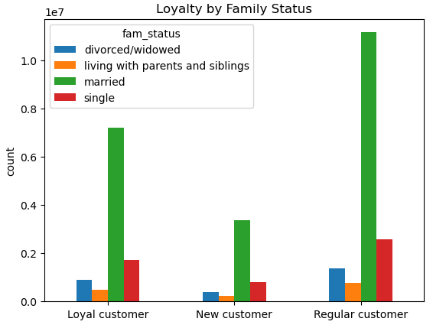
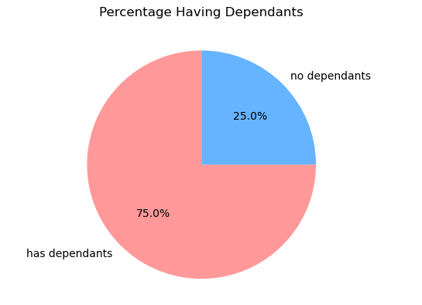
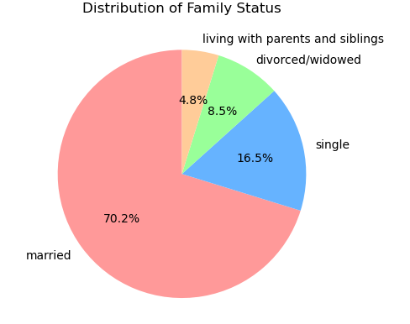
Instacart Analysis
75% of Instacart’s customers have dependents
70.2% of Instacart’s customers are married
The married population is Instacart’s primary customer group

Slide 4
Instacart Recommendations
Next Steps
Focus advertising during off-peak hours to maximize engagement without overwhelming operational capacity.
Promote Popular Products: Feature top product categories in marketing campaigns.
Analyze what motivates regular customers to spend more and use that to tailor loyalty programs or promotions to encourage their long-term retention.
Regular customers contribute significantly to revenue and may be underutilized as a growth area for loyalty programs.
Using targeted marketing efforts to incentivize new customers to increase spending and convert regular customers into loyal ones.
Target High-Value Profiles: Focus on married, high-income customers with dependents, especially in the 25-65 age range

